Slide 1

Artificial Intelligence Task
Route Finding
Algorithms

Slide 2

CONTENTS
01
02
03
04
PART 01
PART 02
PART 03
PART 04
Explain the idea of the application.
Explain how to show the cost between nodes.
Explain UCS Algorithm.
Explain A* Algorithm.

Slide 3

01
The idea of application

Slide 4

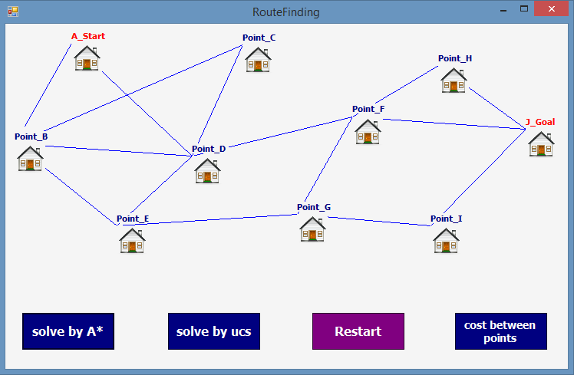
idea of app
Here we explain our app idea.
The game contains a group of nodes connected together in a number of ways. The required is choosing the shortest path to reach the specified node with the lowest cost.
To find the shortest path, our app uses one of two Algorithms : UCS or A* algorihms.

Slide 5
02
Cost between nodes

Slide 6
Cost between nodes
In order to see the cost between each two nodes, press on the button that name is cost between points.
A small screen will appear, it showing the cost between each two nodes in application.
To exit from this screen, click the ok button or exit mark.

Slide 7
03
UCS Algorithm

Slide 8
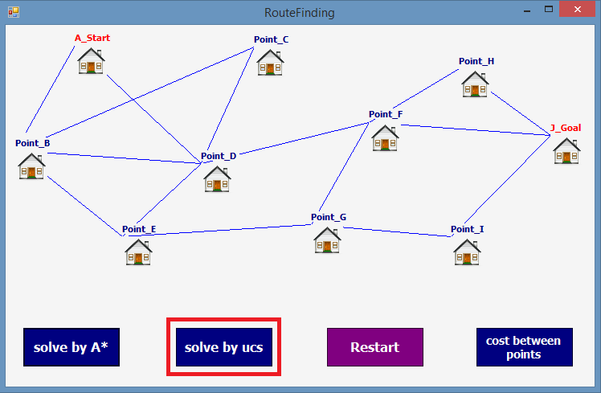
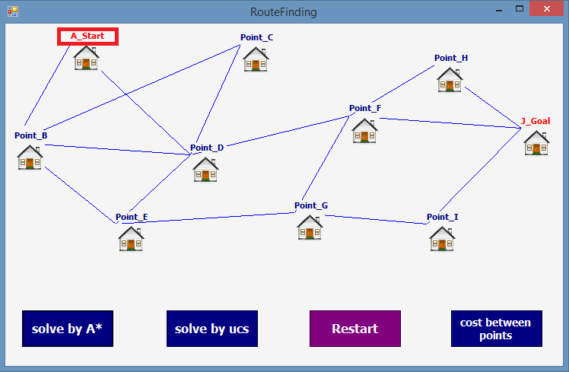
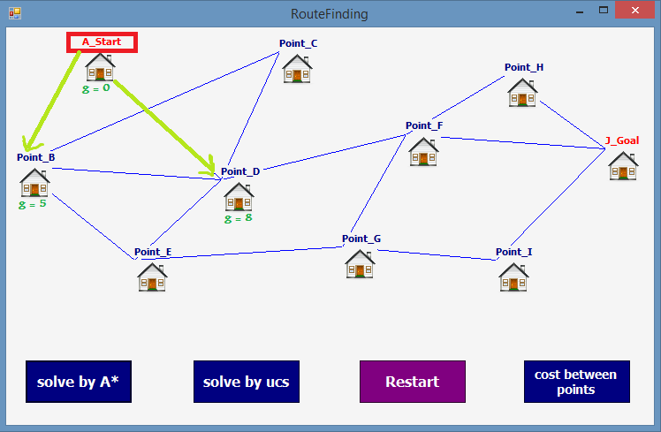
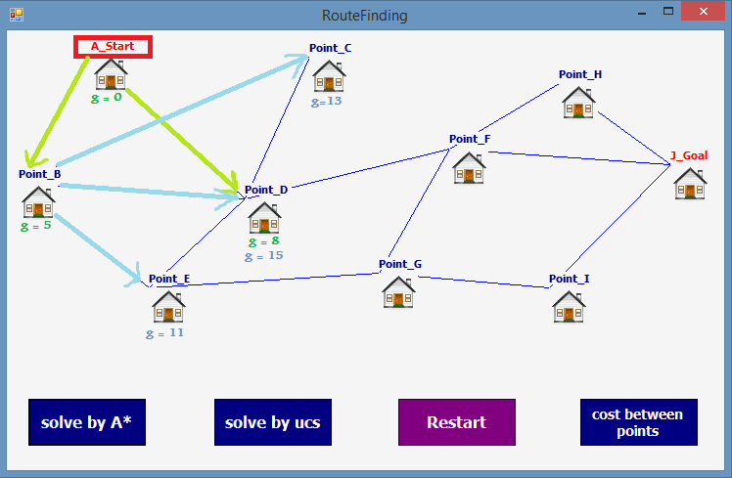

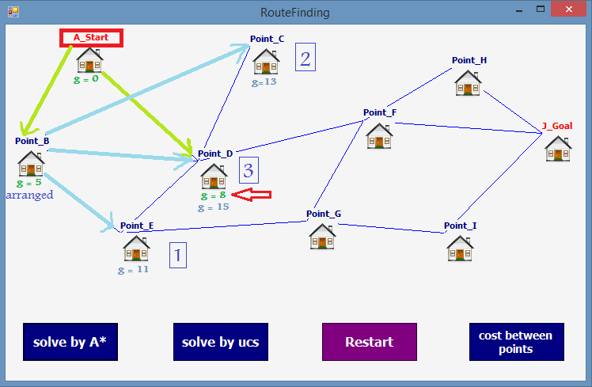
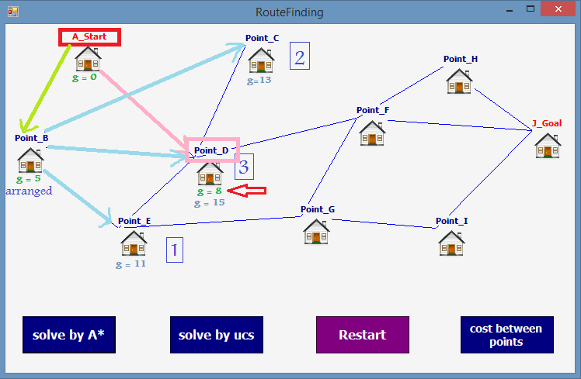
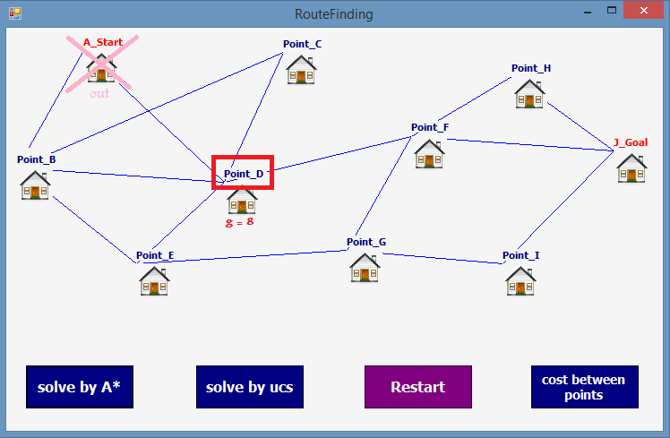
Find shortest path by using UCS algoritm
click button that solve by ucs algorithm.
it start from first node.
determine the nodes that connected with start node.
determine the nodes that connected with B node.
arrange nodes that connected with B node from smallest to biggest.
from A to D in direct is smallest path than from A to B and to D.
determine the next node , that will be there in next step.
it now in D node.

Slide 9
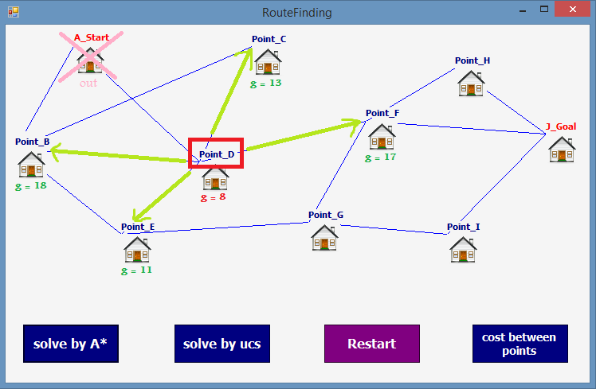
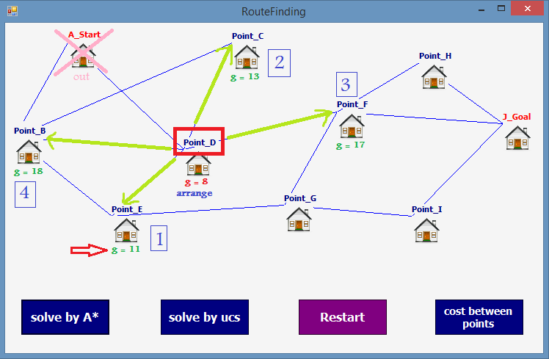

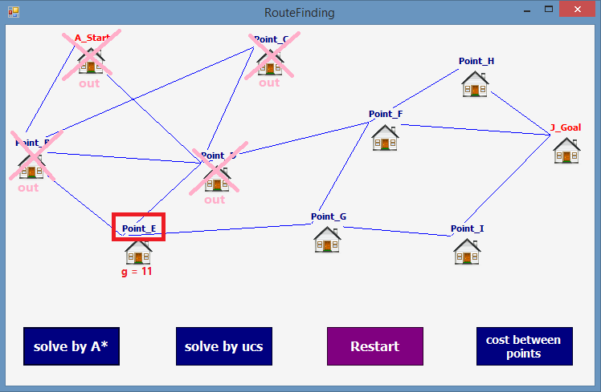
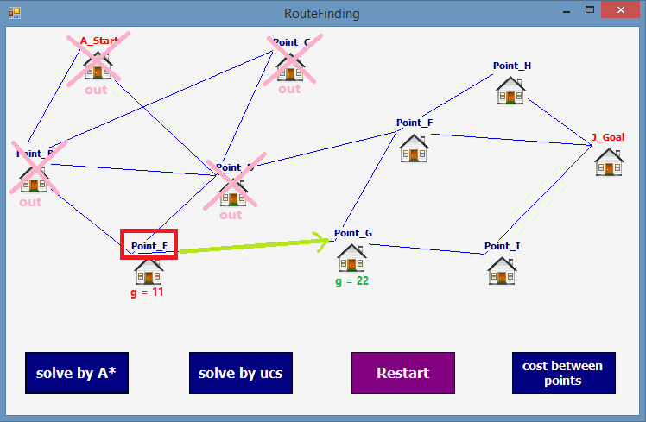
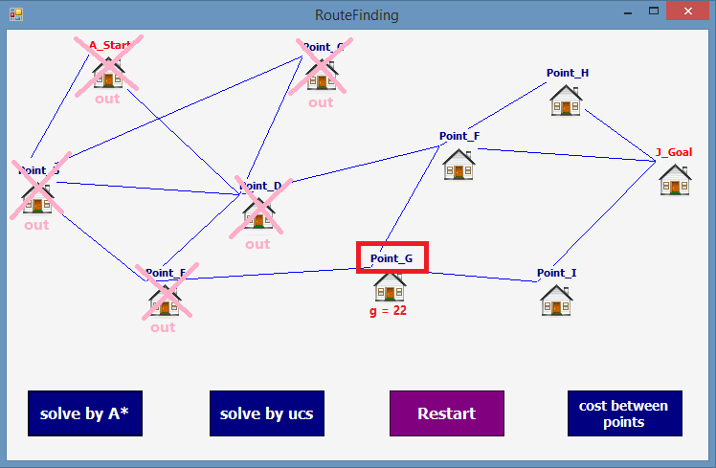
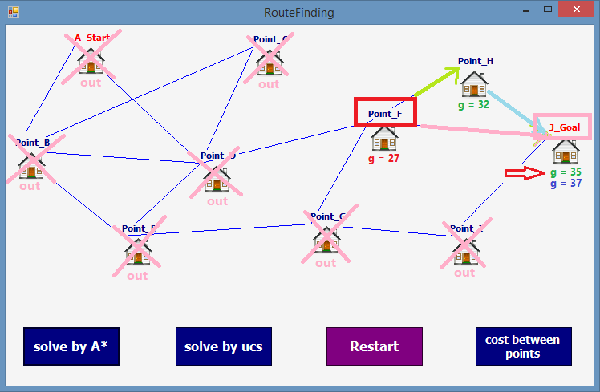
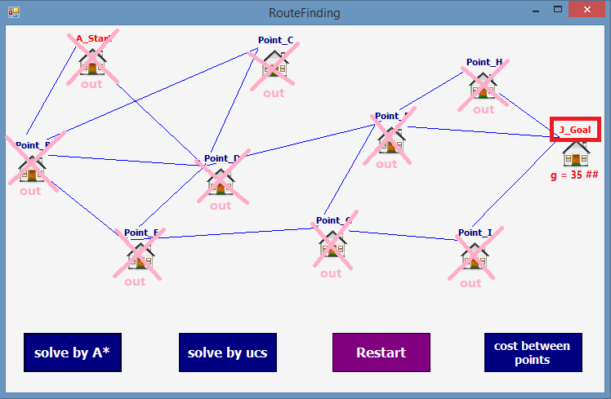
Find shortest path by using UCS algoritm
determine the nodes that connected with D node.
determine the smallest node.
determine the next node , that will be there in next step.
it now in E node.
determine the nodes that connected with E node.
it now in G node.
it will use algorithme until arrive to goal.
now it is in goal node.

Slide 10
Find shortest path by using UCS algoritm
GIF image that explain ucs algorithm in our app

Slide 11
04
A* Algorithm

Slide 12
Find shortest path by using A* algoritm
A* Algorithm
A* Algorithm is one of the best and popular techniques used for path finding and graph traversals.
Working
A* Algorithm extends the path that minimize the following function : f(n) = g(n) + h(n)
==>Here
'n' is the last node on the path
g(n) is the cost of the path from start node to node 'n'
h(n) is a heuristic function that estimates cost of the cheapest path from node 'n' to the goal node

Slide 13
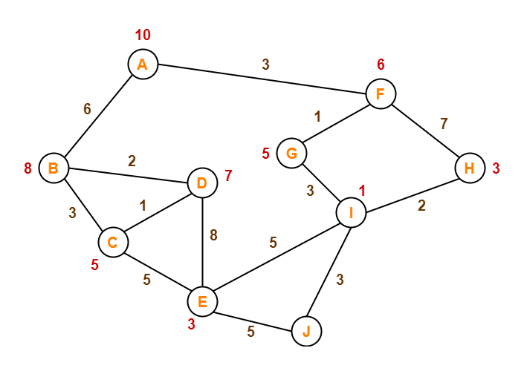
Find shortest path by using A* algoritm
Ex :
Consider the following graph -
The numbers written on edges represent the distance between the nodes.
The numbers written on nodes represent the heuristic value.
Find the most cost-effective path to reach from start state A to final state J using A* Algorithm.

Slide 14
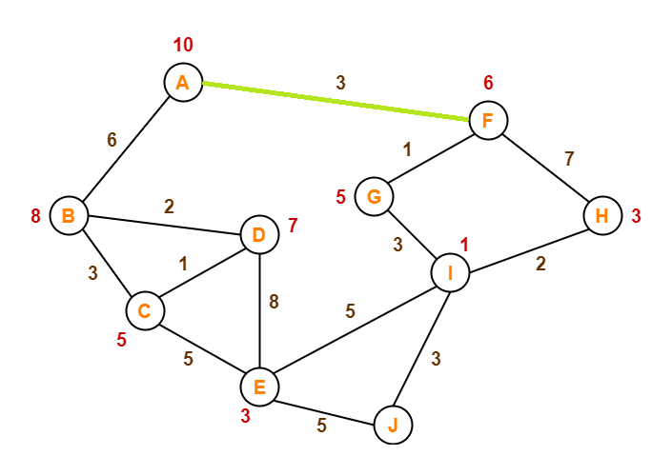
Find shortest path by using A* algoritm
Solution :
step-01:
we start with node A.
Node B and Node F can be reached from node A.
A* Algorith calculates f(B) and f(F).
f(B) = 6 + 8 = 14
f(F) = 3 + 6 = 9
Since f(F) < f(B), so it decides to go to node F.
Path : A → F

Slide 15
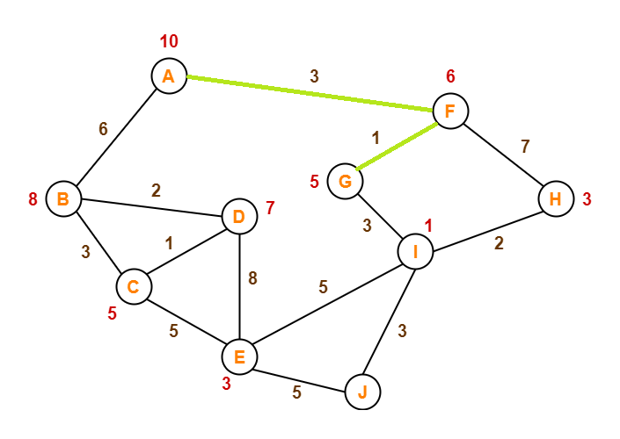
Find shortest path by using A* algoritm
Solution :
step-02:
Node G and Node H can be reached from node F.
A* Algorithm calculates f(G) and f(H).
f(G) = (3+1) + 5 = 9
f(H) = (3+7) + 3 = 13
Since f(G) < f(H), so it decides to go to node G.
Path : A → F → G

Slide 16
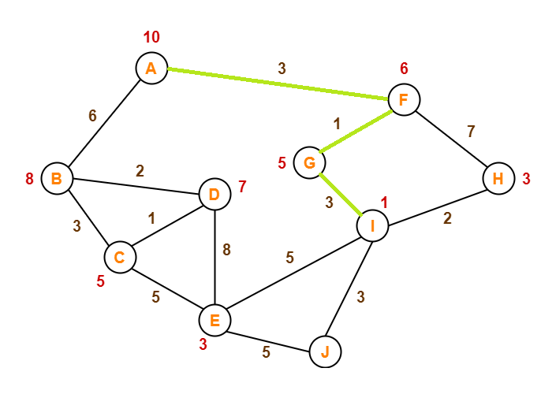
Find shortest path by using A* algoritm
Solution :
step-03:
Node I can be reached from node G.
A* Algorithm calculates f(I).
f(I) = (3+1+3) + 1 = 8
It decides to go to node I.
Path : A → F → G → I

Slide 17
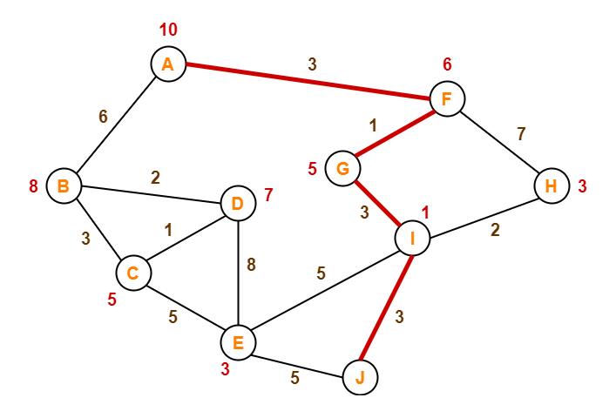
Find shortest path by using A* algoritm
Solution :
step-04:
Node E, Node H and Node J can be reached from node I.
A* Algorithm calculates f(E), f(H) and f(J).
f(E) = (3+1+3+5) + 3 = 15
f(H) = (3+1+3+2) + 3 = 12
f(J) = (3+1+3+3) + 0 = 10
Since f(J) is least, so it decides to go to node J.
Path : A → F → G → I → J
This is the required shortest path from node A to node J.
A* refernce : https://www.gatevidyalay.com/a-algorithm-a-algorithm-example-in-ai/

Slide 18
05
our team ^_^

Slide 19
Names of team members
all members from sec 2
Aya Adel Mohammed
Amira Mohammed
Amira Mahmoud
Amira Alaa

Slide 20
THANKS

